Slide 1

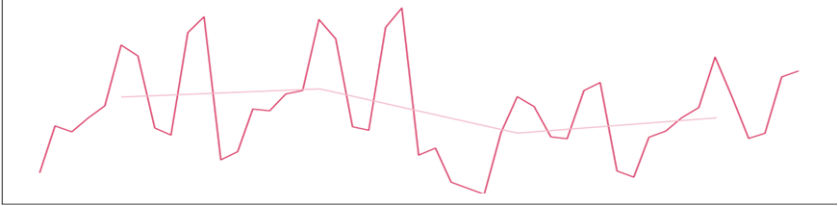
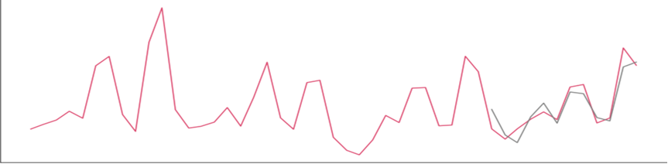




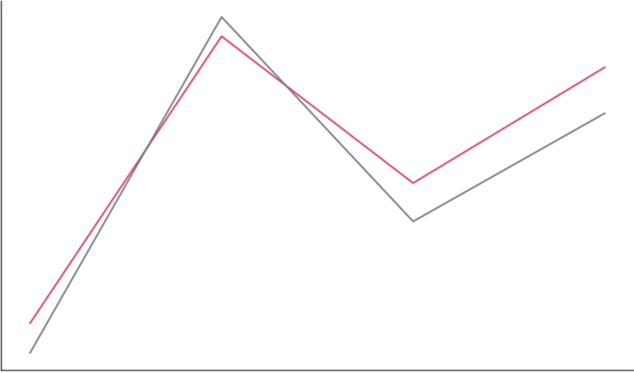
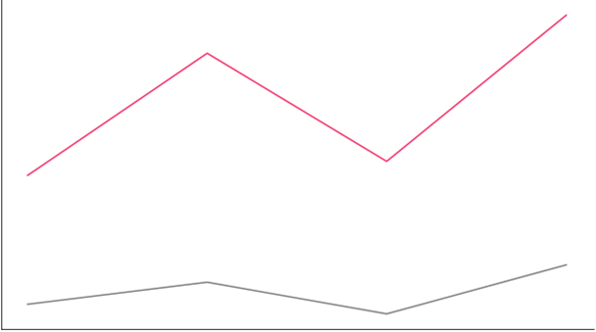

LITERATURE REVIEW
STATISTICAL RESULTS
EXPECTED BUSINESSIMPACT
We referred to the following papers regarding demand forecasting and optimization for our study.
Prediction: ARIMA time series modeling (Shuyun Ren et al., 2017), customer churn prediction (Andrés Martínez et al., 2020), forecasting retail sales deploying ARIMA and GLM (Ilan Alon et al., 2001)
Optimization: Price optimization for an online fashion retailer (Hanwei Li)
We chose the models with the best performance to predict the demand and adapted into the optimization function.
Method 1
(1) Predict sales quantity of each category using time series modeling on python
(2) Optimize the price, discount rate, and pattern-to-solid ratio using non-linear programming on SAS
We aim to optimize the products' pattern-to-solid ratio and the price of each item category. This will help the pattern-making company to maximize the sales with the best product mix decision, secure their loyal customer group, and attract new customers with the optimal discount rate without harming their business.
Optimize the products' pattern-to-solid ratio and a healthy product portfolio.
Set an optimal retail price and discount rate for each category to maximize the net sales ($).
Based on the optimal ratio of pattern-to-solid for each category, the company can plan which product categories to focus on and how the pattern-to-solid ratio should be for the following year.
Help our clients to make the best decision on the items to maximize the sales.
Assist the decision-making in campaign or promotion planning.
Time Series Trend in Sales
Sales Prediction (Random Forest)
Accuracy : 86.4%
Study | Prediction |  |  |  |  | Optimization
 | ARIMA | LSTM | RF | GB | GLM | CP | GD
Shuyun Ren et al. (2017) | V
Andrés Martínez et al. (2020) |  |  |  | V
Ilan Alon et al. (2001) | V |  |  |  | V
Hanwei Li et al. (2021) |  | V |  |  |  | V
Our Study (2022) |  | V | V | V | V |  | V
Sales Quantity
Sales Quantity
Product Pattern Ratio Optimization and Customer Demand Prediction for Pattern Making Company
2018
2019
2020
2021
2022
2018
2019
2020
2021
2022
Total Sale
Date
Avg Sale
Historical
Date
Predicted
Soyeon Baik, Yen Tzu Huang, Ting-Yun Cheng, Huihui Zhang,
Srinikhil Bolneyti, Yang Wang
Purdue University, Krannert School of Management
baik6@purdue.edu;huan1627@purdue.edu; cheng497@purdue.edu; zhan4110@purdue.edu; sbolneyt@purdue.edu;yangwang@purdue.edu
Fig 2. Sales Trend (Time Series) and Prediction Model (Random Forest)
Table 1. Literature Summary
Ratio of Pattern-to-Solid Comparison by Category
METHODOLOGY
anklets
baby apparel/accessories
rings
CONCLUSIONS
Pattern %
100%
29%
100%
39%
52%
29%
ABSTRACT
Solid %
71%
71%
To maximize the revenue for a fashion company, which has a specific business problem, we conducted two methods to optimize some decision variables-the pattern-to-solid ratio and price: Time series with non-linear programming optimization model and machine learning models with sensitivity analysis.
In the sales prediction, time series analysis performed the best with an accuracy rate of 86.4%. Also, we found the different ratios of pattern-to-solid by each category, which can be utilized in the product planning for the future.
Based on our study, the fashion company can determine the optimal price, discount rate, and pattern-to-solid ratio of each category that maximize that revenue.
Prediction and optimization methods are used to find the optimal ratio of pattern-to-solid for a pattern-making company. This will allow them to maximize sales under the control of specific conditions in their business. Prediction and optimization models from python libraries are applied to determine the quantity for each product category and maximize sales by controlling the pattern-to-solid ratio and other variables.
Raw Data
Data Pre-processing
Exploratory Data Analysis
Feature Engineering
61%
48%
Predictive Analysis
Original Optimized
Original Optimized
Original Optimized
Machine Learning Models
Time Series Models
Fig 3. Pattern-to-Solid Ratio by each category Before and After Optimization
INTRODUCTION
Linear Regression
XG
Boost
Random Forest
Linear Regression
Random
Forest
LSTM
Product assortment and its inventory problem are critical issues in the fast-changing fashion industry. These are especially true for the pattern-making fashion company where the importance of seasonality is greater than that of the solid item-based fashion company.
We recognized the difference in the pattern-to-solid ratio of each product category and leveraged them into the sales optimization problem. Also, the discount rate is different between pattern and solid product, and that of the pattern is higher. This is an important issue that a pattern-making company should focus on. So, we used these parameters to optimize to maximize the sales.
For the demand prediction, the time series approach and ensemble models, which include bagging and boosting methods are used. For the optimization, non-linear programming methods are used.
Mehtod2
Predict sales quantity of each category using various machine learning models on python.
Select models with the highest R-square value.
Optimize price, discount rate, and pattern-to-solid ratio to maximize the net sales on python.
Model Comparison & Evaluation (R^2, MSE)
Model Comparison & Evaluation (R^2, MSE)
Remodeling & Prediction
Remodeling & Prediction
ACKNOWLEDGEMENTS
Sales Prediction (XG Boost)
Sales ($) Optimization (XG Boost)
Optimization
Sensitivity Analysis
Non-linear Programming
We would like to take this opportunity to thank Professor Matthew Lanham, Professor Yang Wang, and our industry partner for this experience, their guidance, and support on this project.
Retail Price
Discount Rate
Objective Function
Decision Variables
A set of Constraints
Sales Quantity
Net Sales
Optimal Solutions with Maximum Net Sales
Optimal Solutions with Maximum Net Sales
R-square: 0.79
Comparison of different Optimal Results
Spring
Summer
Fall
Winter
Spring
Summer
Fall
Winter
RESEARCH OBJECTIVES
Season
Season
What predictors play an important role in predicting sales quantity?
Which model performs best in predicting customers’ demand?
What is the optimal retail price, discount rate, and pattern-to-solid ratio for each product category that maximizes sales?
Deployment
Historical
Predicted
Average
Optimized
Fig 1. Methodological Framework
Fig 4. Sales Prediction and Optimization Model (XGBoost)

